Slide 1
Object Oriented Programming CSE-208(L) Lab: 05 Getting Familiar with Object Oriented Environment (Types of Inheritance) Engr. Durr-e-Nayab

Slide 2
Agenda for Today
To know and understand different criterions for types of inheritance
To understand the concept of overriding
To understand the concept of overloading
2

Slide 3
Public, Private, Protected Inheritance
“Type 01”
class_name : protected base_classes
class_name : public base_classes
class_name : private base_classes
We call these:
Public/Protected/Private Inheritance

Slide 4
Public Inheritance
All Public members of the Base Class become Public Members of the derived class
& All Protected members of the Base Class become Protected Members of the Derived Class.

Slide 5
Public Inheritance
Class Base
{ public:
int a;
protected:
int b;
private:
int c; };
class Derived:public Base
{ void doSomething()
{ a = 10; //Allowed ….. ‘a’ becomes Public member of Derived
b = 20; //Allowed ……. ‘b’ becomes protected member of Derived
c = 30; //Not Allowed, Compiler Error ….. Derived cannot access private member c of Base} };
int main()
{ Derived obj;
obj.a = 10; //Allowed
obj.b = 20; //Not Allowed, Compiler Error
obj.c = 30; } //Not Allowed, Compiler Error

Slide 6
Protected Inheritance
All Public members of the Base Class become Protected Members of the derived class
& All Protected members of the Base Class become Protected Members of the Derived Class.

Slide 7
Protected Inheritance
Class Base
{
public:
int a;
protected:
int b;
private:
int c;
};
class Derived: protected Base
{
void doSomething()
{
a = 10; //Allowed ….. a becomes protected member of Derived
b = 20; //Allowed ……. b becomes protected member of Derived
c = 30; //Not Allowed, Compiler Error ….. Derived cannot access private member c of Base
}
};
int main()
{
Derived obj;
obj.a = 10; //Not Allowed, Compiler Error
obj.b = 20; //Not Allowed, Compiler Error
obj.c = 30; //Not Allowed, Compiler Error }

Slide 8
Private Inheritance
All Public members of the Base Class become Private Members of the derived class
& All Protected members of the Base Class become Private Members of the Derived Class.

Slide 9
Private Inheritance
Class Base
{
public:
int a;
protected:
int b;
private:
int c;
};
class Derived: private Base
{
void doSomething()
{
a = 10; //Allowed ….. a becomes private member of Derived
b = 20; //Allowed ……. b becomes private member of Derived
c = 30; //Not Allowed, Compiler Error ….. Derived cannot access private member c of Base
}
};
int main()
{
Derived obj;
obj.a = 10; //Not Allowed, Compiler Error
obj.b = 20; //Not Allowed, Compiler Error
obj.c = 30; //Not Allowed, Compiler Error }

Slide 10
Public, Protected, Private Inheritance
class A {
public:
int i;
protected:
int j;
private:
int k;
};
Class B : public A {
// ...
};
Class C : protected A
{
// ...
};
Class D : private A {
// ...
};
Class A declares 3 variables
i is public to all users of class A
j is protected. It can only be used by methods in class A or its derived classes (+ friends)
k is private. It can only be used by methods in class A (+ friends)
Class B uses public inheritance from A
i remains public to all users of class B
j remains protected. It can be used by methods in class B or its derived classes
Class C uses protected inheritance from A
i becomes protected in C, so the only users of class C that can access i are the methods of class C
j remains protected. It can be used by methods in class C or its derived classes
Class D uses private inheritance from A
i and j become private in D, so only methods of class D can access them.

Slide 11
Single and Multiple Inheritance
(Type 2)
Single Inheritance
Class inherits from one base class
Multiple Inheritance
Class inherits from multiple base classes
A class can be derived from more than one classes
The order in which the constructors of base classes are called is not dependent on the order of mentioning constructors in base class initializer
It is dependent on the order in which inheritance is specified in the derived-class definition

Slide 12
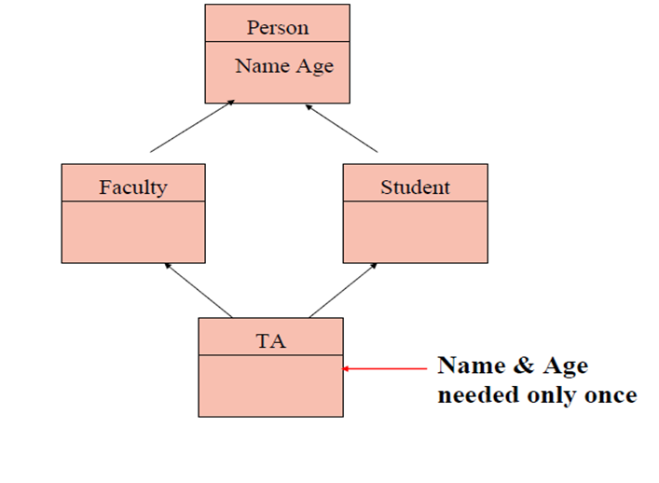
Multiple Inheritance
(Syntax)
Derived_Class: Base_Class1, Base_Class2
i.e.
Class TA: public Faculty, public Student

Slide 13
Quick Example
(Multiple Inheritance)
#include <iostream.h>
class A
{ private:
int num1;
public:
A():num1(0)
{cout<<"Class A constructor..."<<endl;}};
class B
{private:
int num2;
public:
B():num2(0)
{cout<<"Class B constructor..."<<endl; }};
class C: public B, public A
{
public:
C()
{cout<<"Class C constructor..."<<endl; }};
void main()
{ C obj; }

Slide 14
Multi Level Inheritance
(Type 3)
Multi-Level Inheritance
Class inherits from another child class

Slide 15
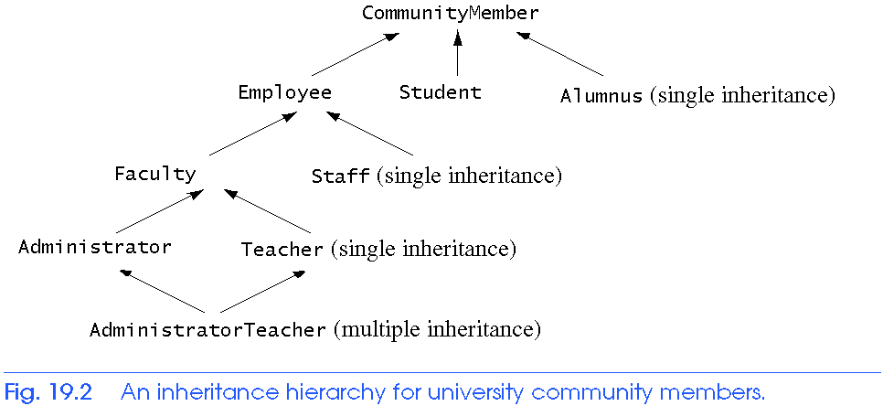
Multiple and Multi Level Inheritance
Multi-Level Inheritance
Multi-Level Inheritance

Slide 16
Quick Example
(Multi Level Inheritance)
#include<iostream>
class Person {
int x;
public:
Person(int val) {x=val} };
class Faculty : public Person {
public:
Faculty() {} };
class TA : public Faculty {
public:
TA() {} };
int main() {
TA ta1(30);}

Slide 17
What happens now?
class printData
{ public:
void print(int i)
{ cout << "Printing int: " << i << endl; }
void print(double f)
{ cout << "Printing float: " << f << endl; }
void print(char* c)
{ cout << "Printing character: " << c << endl; } };
class copyData:public printData {};
int main(void)
{ copyData pd;
pd.print(5);
pd.print(500.263);
pd.print("Hello C++");
return 0; }

Slide 18
This was “Overriding”

Slide 19
Overriding member functions of the base class
A derived class can override the member functions of its base class
To override a function of base class, the derived class provides a function with same signature as that of the base class
So derived class function overrides the base class function
Base class functions are overridden if we want to change the functionality of base class function
Functions can be totally changed
A few new additions can be made in the overriding function
Derived class method and base class method have same signatures but when this function is called on a derived class object, the function of derived class object will be called although the base class functions are making the interface of the derived class
To explicitly call the base class overridden function, use parent_class_name::member_function_name(…)

Slide 20
Quick Example
#include <iostream.h>
class A
{ private:
int num1;
public:
A(): num1(0) {}
void display()
{ cout<<"Number 1: "<<num1<<endl; }};
class B: public A
{private:
int num2;
public:
B():num2(0) {}
void display()
{ cout<<"Number 2: "<<num2<<endl; }};
void main(){
B obj;
obj.display(); //display of class B called
obj.A::display(); //display of class A called }

Slide 21
What happens, If there are display functions in each of the three classes in slide 13 Quick example? Which class’ display function gets called if the statement obj.display(); gets executed? Write statements to call the display function of all the three classes on obj.

